Slide 1


Experiential Learning
Project Assessment-I
on
“QR CODE ENCODER / DECODER”
under the course
Python ProgrammingLanguage(N-PCCCM304P)
Presented By:
Kanak Bhimte
[CM25021]
Under the Guidance of
Mrs. Mayuri Getme
Session:2026-27 (ODD )
Department of CSE(AI&ML)
S. B. JAIN INSTITUTE OF TECHNOLOGY MANAGEMENT AND
RESEARCH,NAGPUR
An Autonomous Institute, Affiliated to RTMNU, Nagpur
)

Slide 2
1. Problem Statement
Develop a simple Python system to generate QR codes from text or URLs.
Decode information stored in QR code images.
Provide a simple menu-driven interface for encoding and decoding.
Handle invalid input, empty input, and missing image files with error messages.

Slide 3
2. Objective
• To generate QR codes from text or URLs.
• To decode information from QR code images.
• To save generated QR codes as PNG image files.
• To provide a simple menu for Encode, Decode, and Exit.
• To understand the practical use of Python libraries such as qrcode, OpenCV, and os.
.

Slide 4
3. Algorithm
1. Start the program.
2. Display the main menu: Encode, Decode, or Exit.
3. Ask the user to enter a choice.
4. If Encode is selected, take text or URL as input.
5. Check that the input is not empty.
6. Take the output filename; use myqr.png if no filename is given.
7. Generate the QR code using the qrcode library and save it as PNG.
8. If Decode is selected, take the QR image filename.
9. Check whether the image file exists and can be read.
10. Convert the image to grayscale and detect the QR code using OpenCV.
11. Display the decoded data if a QR code is detected.
12. If Exit is selected, stop the program.
13. Handle invalid menu choices and runtime errors.

Slide 5
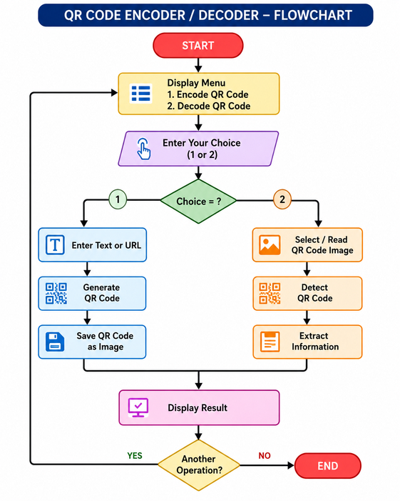
4. Flowchart

Slide 6
5. Understanding of python logic
• Takes input from the user using input().
• Uses functions: encode_qr(), decode_qr(), show_menu(), and main().
• Uses if-elif-else conditions to control Encode, Decode, and Exit.
• Uses while True to keep showing the menu until Exit is selected.
• Uses the qrcode library to create and save QR codes.
• Uses OpenCV QRCodeDetector to read and decode QR images.
• Uses os.path.exists() to check whether the image file exists.
• Uses try-except to handle errors without abruptly stopping the program.

Slide 7
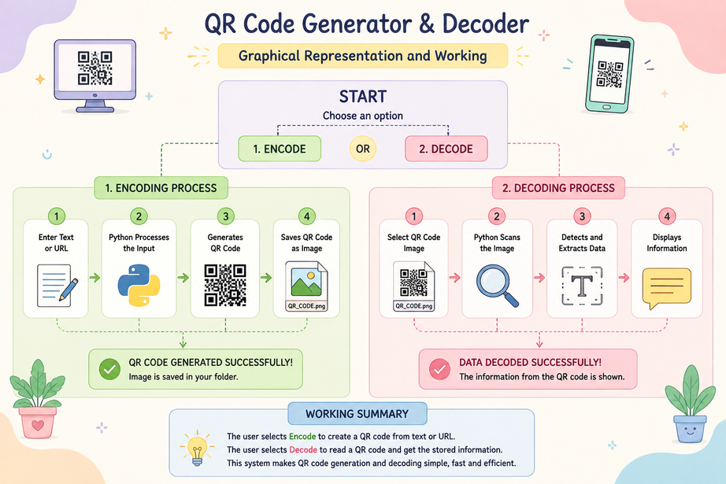
6. Graphical Representation and Working

Slide 8
7. GitHub Account, Repository & Collaboration
• Created a GitHub repository to store the QR Code Encoder/Decoder project.
• Uploaded the Python source code to the repository.
• Used GitHub to keep the project organized and accessible.
• Changes and updates can be tracked using commits.
• Team members can collaborate by sharing and updating the repository.
• GitHub helps maintain a backup and version history of the project.

Slide 9
8. Individual Contribution
● ● ● ● ● ●
• Problem Analysis – Understood the requirements of QR code encoding and decoding.
• Algorithm Design – Designed the menu-driven flow for Encode, Decode, and Exit.
• Python Coding – Implemented QR generation, image decoding, input validation, and error handling.
• Testing – Tested text/URL input, PNG saving, image reading, and QR decoding.
• GitHub Contribution – Uploaded the project code and maintained project updates.
• Documentation & PPT – Prepared project documentation and presentation slides.

Slide 10
Thank You
“QR CODE ENCODER / DECODER”
Presentation by- Kanak Bhimte (CM25021)

